Slide 1
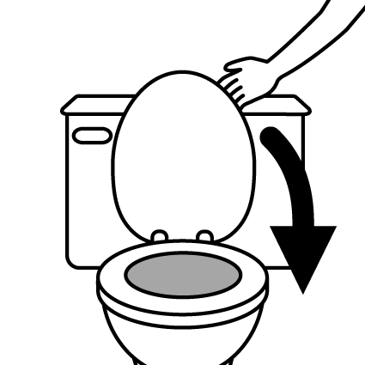

USING THE TOILET
1
Do not touch surfaces (including light switch, door lock and flush) directly with your hands: use a tissue or toilet paper
Clean toilet seat BEFORE use with toilet paper and spray
(please do not put paper towels in toilet. Use pedal bin)
2
Clean toilet seat AFTER use with toilet paper and spray
(please do not put paper towels in toilet. Use pedal bin)
3
4
Close lid before flushing
5
Wash your hands (see instructions by wash basin)
Thank you for your help keeping everyone safe.

