Slide 1

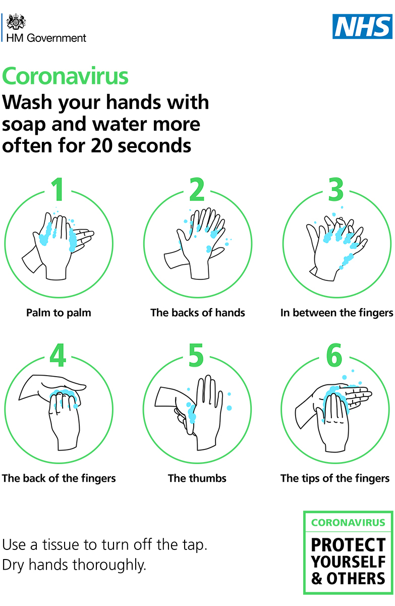
HOW TO WASH YOUR HANDS
1
Do not touch surfaces (including light switch, taps and lock) directly with your hands: use a tissue or toilet paper
2
Turn on tap using paper
3
Press hand soap dispenser with paper, and bin paper
4
Wash your hands following guidance to the right, then turn off tap with paper, and bin it
5
Dry your hands with new paper, then bin it
Thank you for your help keeping everyone safe.

